Slide 1

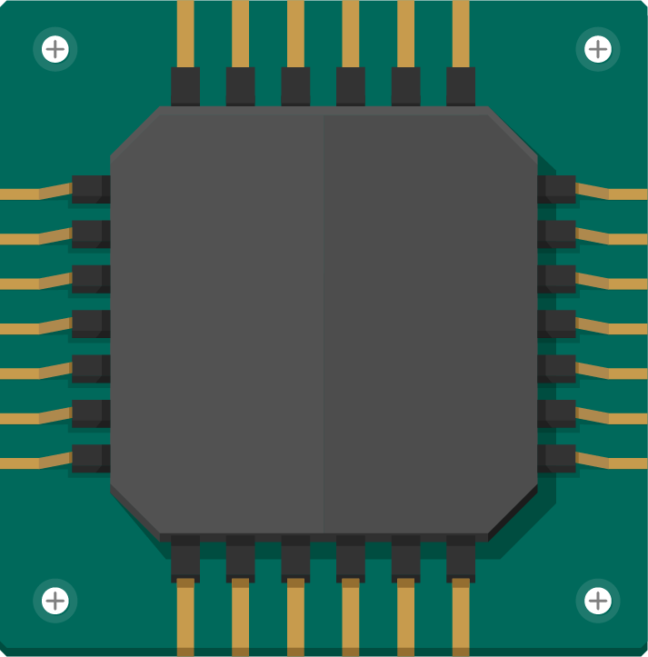
The Superscalar Performance Advantage
Superscalar O3CPU architecture yields major performance gains

Slide 2
Agenda
1
2
3
4
Introduction
Environment Setup
Outputs Analysis
Conclusion

Slide 3
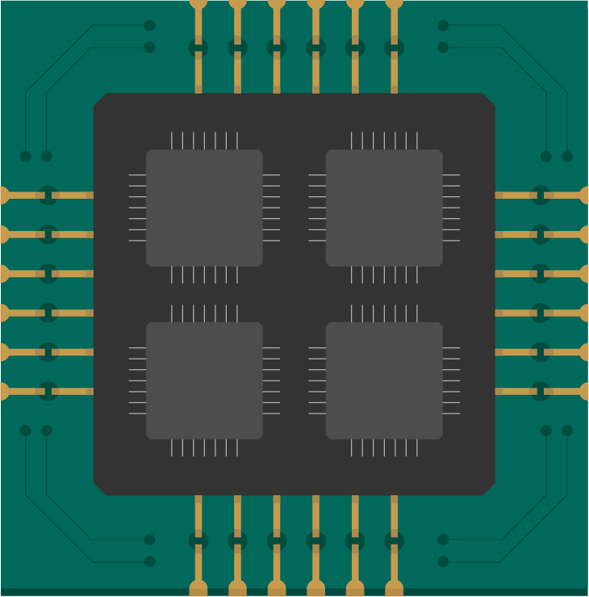
1
Introduction

Slide 4
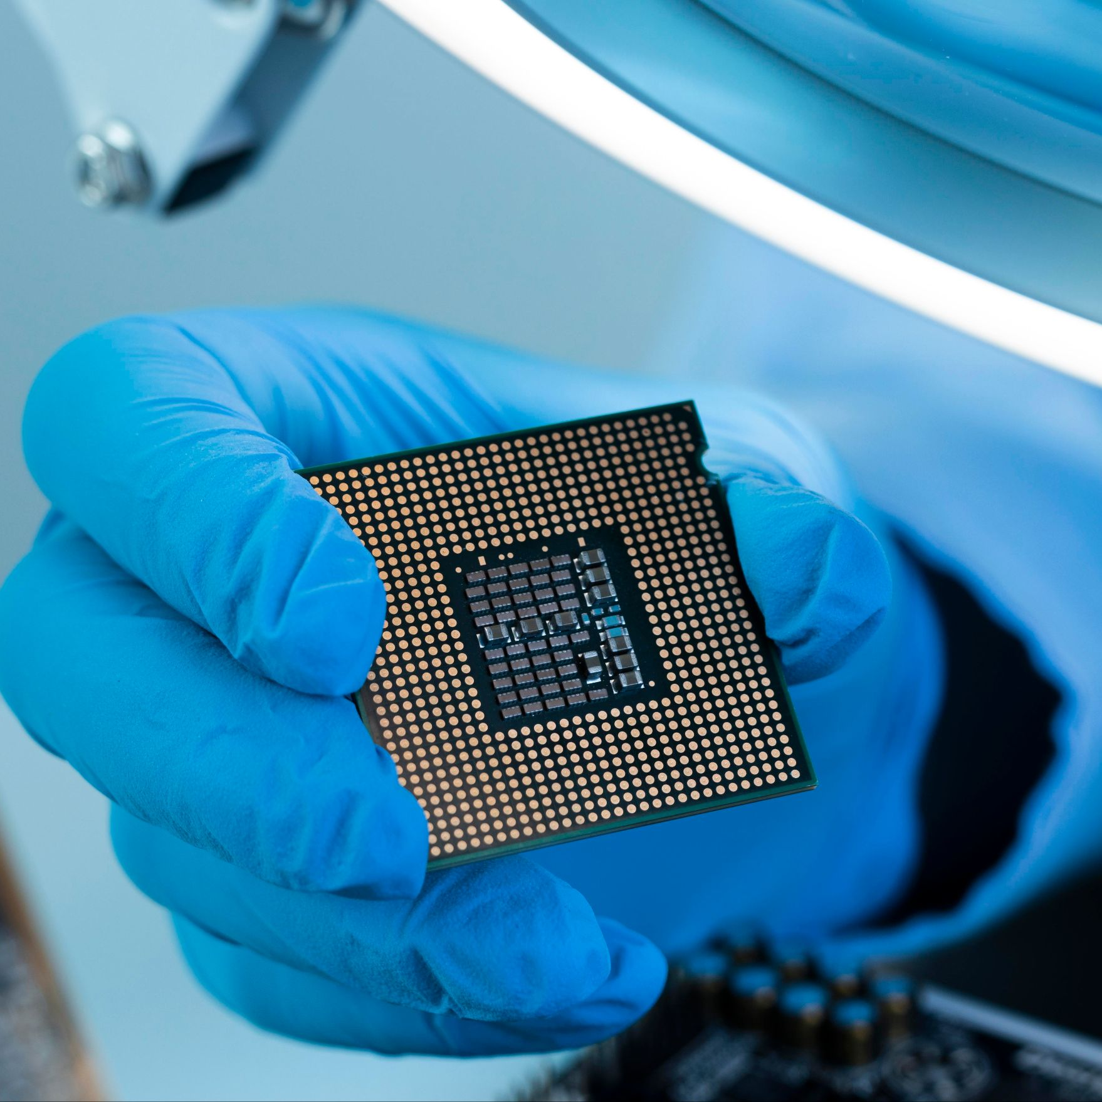
Why did we use gem5 in our project?
The main goal of this project is to study the effect of CPU type on system performance.
We used the gem5 simulator to simulate different processors without the need for real hardware.

Slide 5
Performance comparison between:
O3 CPU (Out-of-Order)
In-Order CPU
O3CPU is a detailed out-of-order CPU model in gem5.
It simulates realistic pipeline behavior for accurate performance analysis.
X86 Minor CPU is a simple, in-order CPU model in gem5.
It provides fast simulation with a lightweight pipeline design.

Slide 6
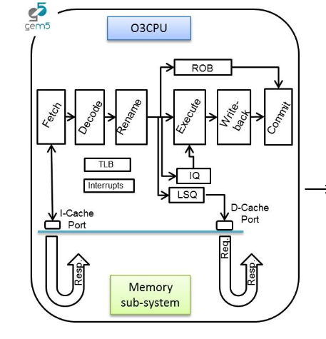
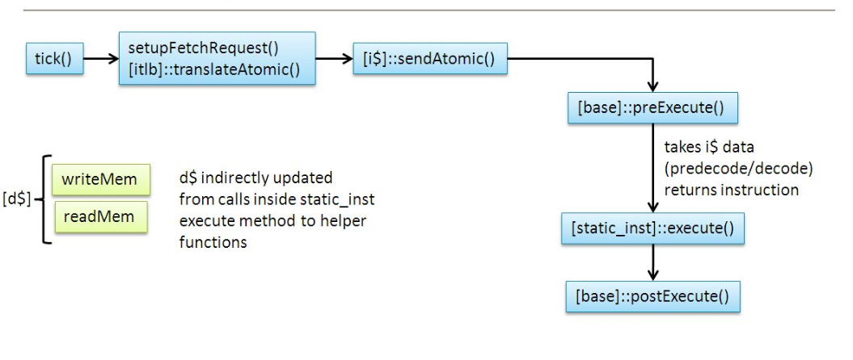
Performance comparison between:
O3CPU
X86 Minor CPU

Slide 7
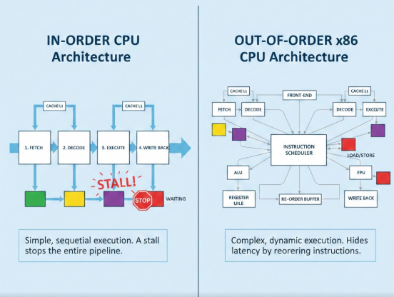
Performance comparison between:

Slide 8
The comparison focuses on:
Execution time
Number of instructions
Number of clock cycles
The total time a program takes to run from start to finish.
It measures how long the CPU spends executing the task.
The total count of machine instructions executed by the CPU
It reflects how much work the program performs during execution.
The total number of CPU cycles needed to execute the program.
It indicates how many cycles the processor spends performing all operations.

Slide 9
2
Environment Setup

Slide 10

This section will talk about the simple code that was used to run the simulation, and showcasing the step by step process.

Slide 11
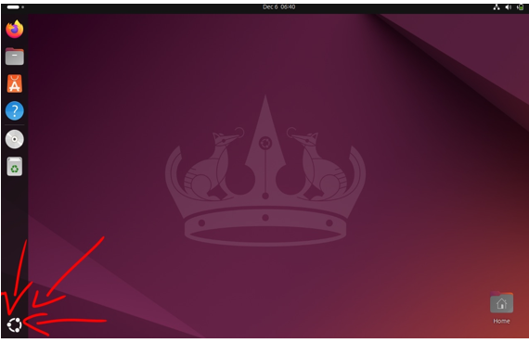
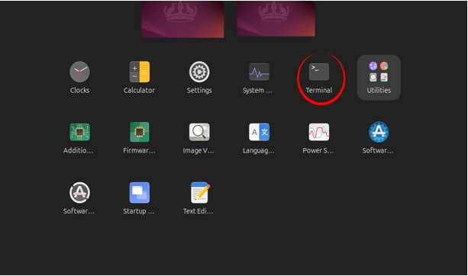
Opening the Terminal.
1
2
We start by clicking on this icon on the bottom left side of the screen.
We double click to open the Terminal.

Slide 12
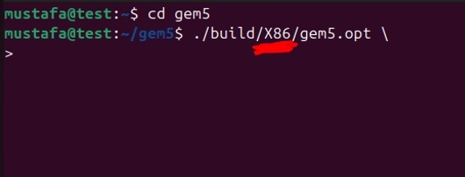
Building the environment code.
3
Before writing any of the code we have to enter the gem5 file using the command “ cd gem5”, this will put us inside of the gem5 directory and from here we can start writing the code for the environment.
We start by typing “./build” and then the board of our choice (X86/ARM/RISC-v etc),
Followed by “gem5.opt”
Important note : the backslashes ‘\’ are not important for the code and are only present to make the code easier to read, you can write all of the following code in one straight line and it will run perfectly fine as long as you keep the spaces between them.

Slide 13
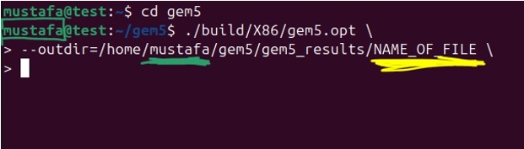
Building the environment code.
4
For the next step we have to select the output file, starting by typing :
“--outdir=/home/accountname”
note that you should match the account name part to the name of your virtual account name, which can be seen inside the terminal itself as shown in the image.
Afterwards we decide the location and name of the file to access and see the results later:
“/gem5/gem5_results/filename”
You can the file name whatever you want, in this example I went with the name “NAME_OF_FILE” to make it easier to follow.

Slide 14
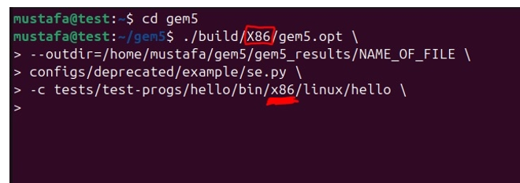
Building the environment code.
5
For the next part of the code we should be careful to match system to the one we already choosen.
So if you picked x86 you put x86 again, ARM with arm, etc...

Slide 15
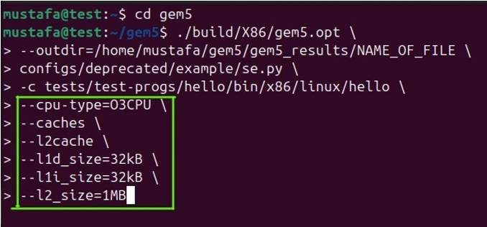
Building the environment code.
6
For the next step we get to customize the specific part of our simulation like the CPU type, the number of caches, and the sizes of said caches.
For our simulation we went with the same storage sizes for the caches for both of the simulations, only changing the CPU type (from O3CPU to X86MinorCPU) to ensure fairness in comparison between the two CPU’s performance.

Slide 16
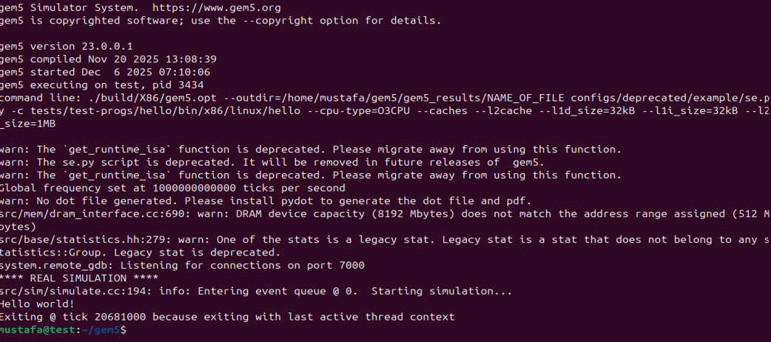
When you hit enter you should see the following
7
This means the simulation ran correctly and the results were outputted ! (congrats !!)

Slide 17
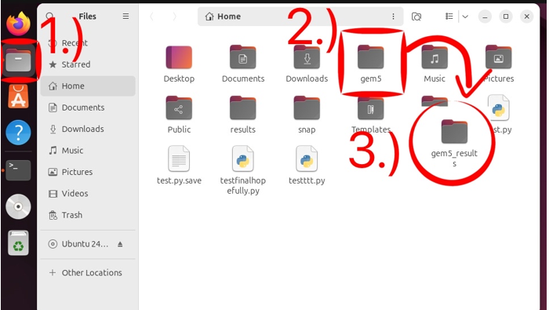
How to access the results file.
8
We go to the files on the virtual machine
We go to gem5 folder
Inside we look for a folder named “gem5_results” and double click on it.

Slide 18
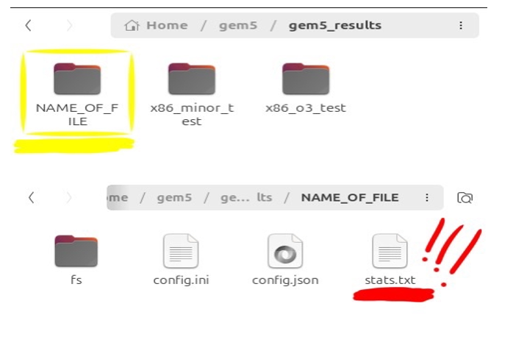
How to access the results file.
9
Lastly inside of gem5_ results we look for a file with the name we’ve chosen earlier, and inside of that file we will find a text file called “stats.txt” that has all of the data we need for analysis.

Slide 19
3
Outputs Analysis

Slide 20


Slide 21
Performance Factors
IPC (Instructions Per Cycle)
Total CPU Cycles
Total Simulation Time
Total Idle Cycles
Max Issue Width
Renaming Maps Committed

Slide 22
Performance Factors
Mean Issue Rate
Total Instructions Issued
Squashed Instructions Issued
Total Instructions Committed

Slide 23
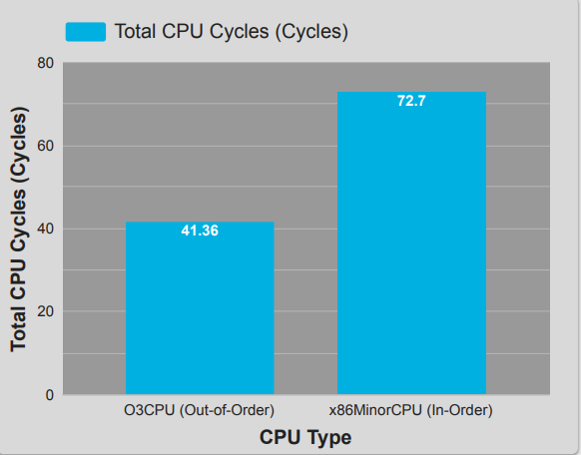
How much processing time did each core waste to complete the same task?
The O3CPU required 41,363 Cycles, while the x86MinorCPU required 72,700 Cycles.
The O3CPU saves nearly 43% of the total execution time.
Cycles: The number of clock ticks the CPU needed.
Fewer cycles = better performance.

Slide 24
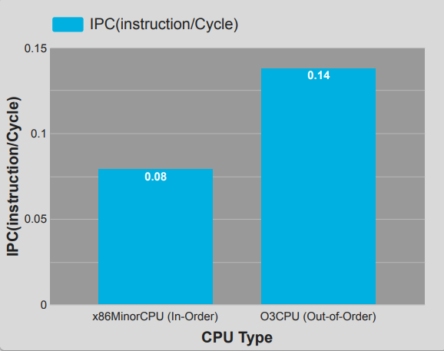
What is the real gain from the Superscalar architecture?
The O3CPU achieved an IPC of 0.14, a 75% increase over the MinorCPU's 0.08.
This directly measures the core's ability to complete instructions in parallel.
Insts/Cycle: The average number of instructions the core completes per clock cycle.
The higher the value, the more efficient the core is.

Slide 25
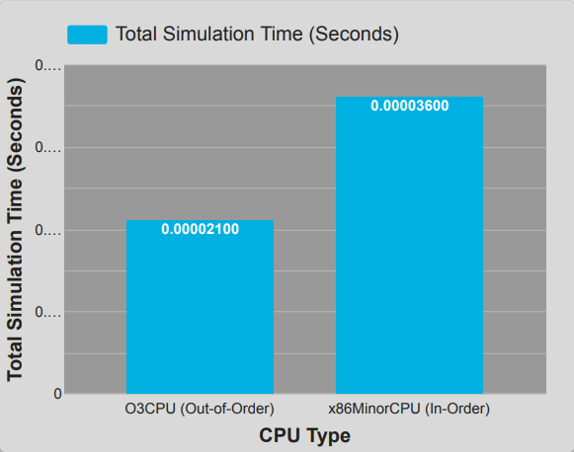
What was the overall time saving for the user?
The O3CPU finished in 21 µs, significantly faster than the MinorCPU's 36 µs.
Seconds: The total wall-clock time required for the simulation to run.

Slide 26
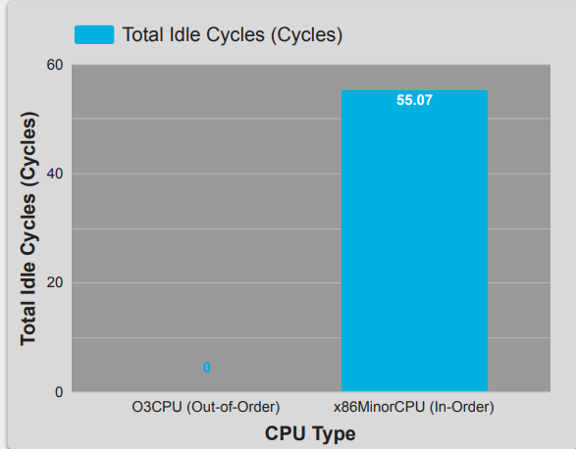
What is the cost of the In-Order pipeline limitation?
The MinorCPU spent 55,070 Cycles being idle/stalled (waiting for data/dependencies), a cost the O3CPU minimized significantly.
Cycles: Measures pipeline stalls. High idle cycles show poor tolerance for memory latency.

Slide 27
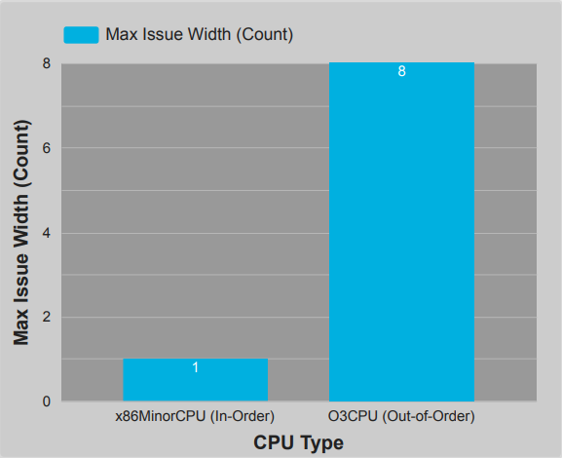
How much parallelism is physically available in each core?
The O3CPU is physically configured for a Max Issue Width of 8, allowing it to attempt sending 8 instructions in parallel, compared to the MinorCPU's limit of 1.
Count: The number of instructions the dispatch unit can send to the functional units per cycle.

Slide 28
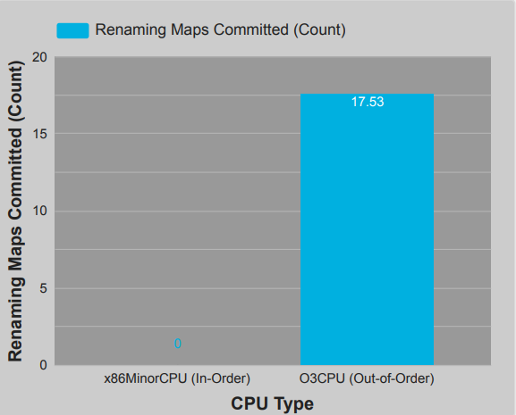
What specific mechanism enables the Out-of-Order execution?
The O3CPU successfully executed 17,534 Register Renaming operations, which is the key mechanism to eliminate false dependencies and enable OOO execution.
Count: The number of times the CPU successfully used its complex renaming hardware to bypass data hazards.

Slide 29
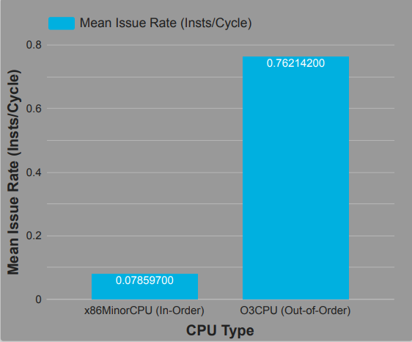
Did the O3CPU actually utilize its wide pipeline?
Yes. The O3CPU achieved a Mean Issue Rate of 0.76 Insts/Cycle, meaning it issued close to one instruction every cycle on average, effectively using its available resources.
Insts/Cycle: The average number of instructions actually issued to the functional units over the simulation.

Slide 30
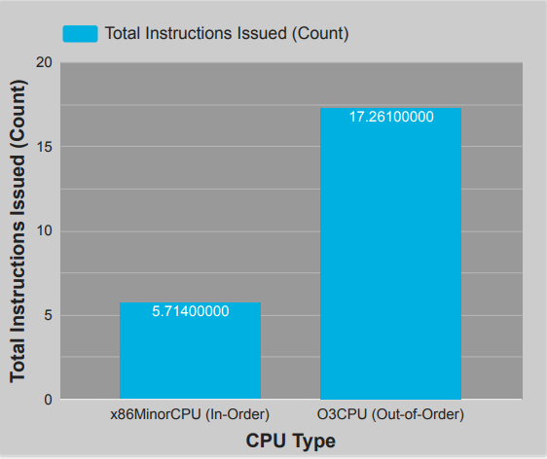
How much speculative work did the O3CPU perform?
The O3CPU issued 17,261 instructions to commit only 5,701 instructions (3x the committed work).
This shows the extent of its aggressive speculative execution.
Count: The total number of instructions entered into the pipeline, including those that may be later discarded.

Slide 31
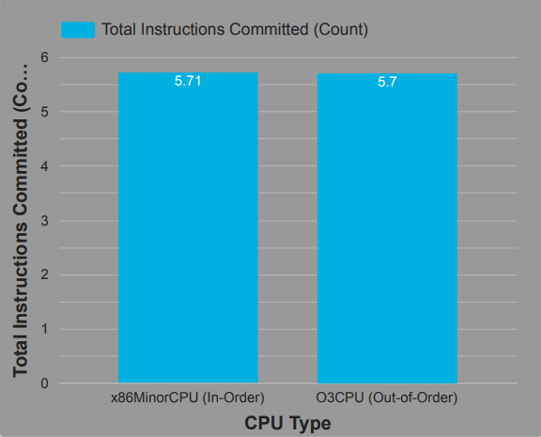
Did the workload remain consistent across both simulations?
Yes. Both cores committed virtually the same number of instructions (5,714 vs. 5,701), validating the comparison base.
Count: The final number of instructions that permanently updated the program state.

Slide 32
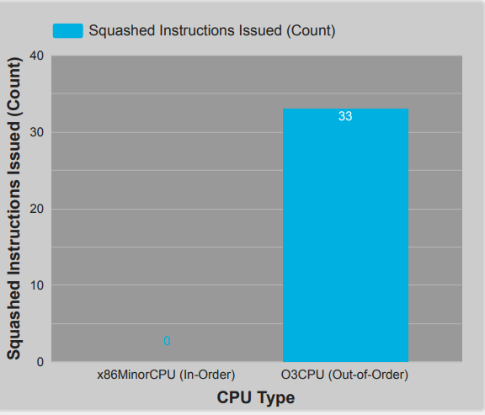
What was the cost of speculation (misprediction)?
Only 33 instructions were squashed (discarded) due to incorrect branch predictions, confirming that the speculative execution was highly efficient.
Count: The number of instructions that had to be canceled and flushed from the pipeline due to a wrong prediction.

Slide 33
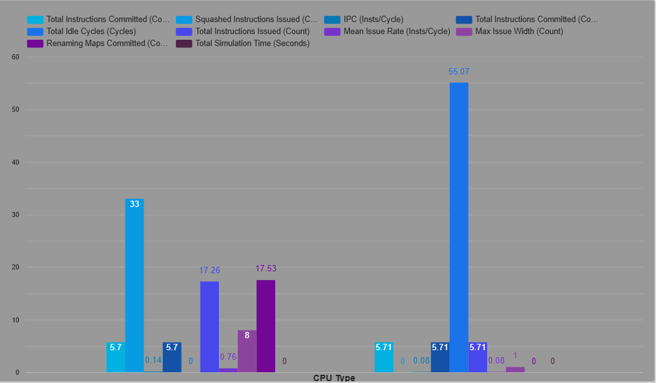
Summary

Slide 34
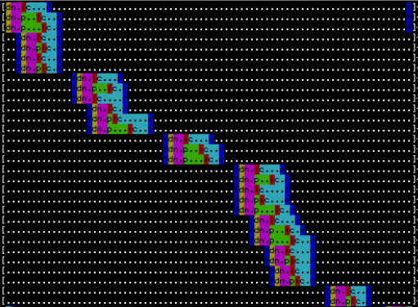
O3CPU Operation Analysis

Slide 35
4
conclusion

Slide 36
- The O3CPU can skip stalled instructions and execute others instead of waiting.

Slide 37
The type of CPU has a significant impact on:
- Program speed
- Performance
- efficiency
- Resource usage

Slide 38
- O3 CPU achieved better results in most tests
- gem5 is an excellent tool for understanding CPU behavior
- VirtualBox provided a stable environment for simulation

Slide 39
supervisor
Dr. Adnan Abu Asbah
Team
Sajed Kittanh
Mustafa Jarrar
Jameel Hamarsheh

Slide 40
Thanks
Do you have any questions?

